Slide 1

Data Science Practitioner
Fellowship Cohort 2022
Final Project Presentations – 6th December 2022
Location Selection and Resource Optimization
Sahand Tahir, WFP & Africa CDC

Slide 2





Location Selection and Resource Optimization
WFP & Africa CDC
My goal in this project is to develop a model or a framework that will assist in finding optimal and data-driven solutions and find best answers for our questions.
For this case study, I am using the example of Africa CDC, which is one of our partners. How do we assist them to take data driven decision for their decisions especially when it comes to emergency preparedness and response, strategies and resource allocation.
I will look at the example of placing a new base/ warehouse based on proximity to highly vulnerable areas and other parameters in the context of Ebola outbreaks.
One single point of response
Notes:
It is also worth mentioning, a lot of simplification and assumption were used in this project so the outcomes may not reflect reality as it is, the process and analysis is the focus for this session, since this process can be replicated again on more accurate data and more parameter and real data so that and informed data \
Disclaimer, the data and parameters used in this project is very simplified and I realy a lot on assumptions for now to fill out gaps but the focus is on the model and the thinking rather than the result.

Slide 3
Location Selection and Resource Optimization WFP & Africa CDC
Business Case
First step of enabling data and evidence, to define strategies optimally, reduce costs, and time for more effective and effecient responses and preparedness.
Most Significant Change
On the basis of this model other models can be developed which we can support our partners and Africa CDC in redefining their supply chain strategies in general.
Second optimal location for response
Notes:
It is also worth mentioning, a lot of simplification and assumption were used in this project so the outcomes may not reflect reality as it is, the process and analysis is the focus for this session, since this process can be replicated again on more accurate data and more parameter and real data so that asn informed data

Slide 4
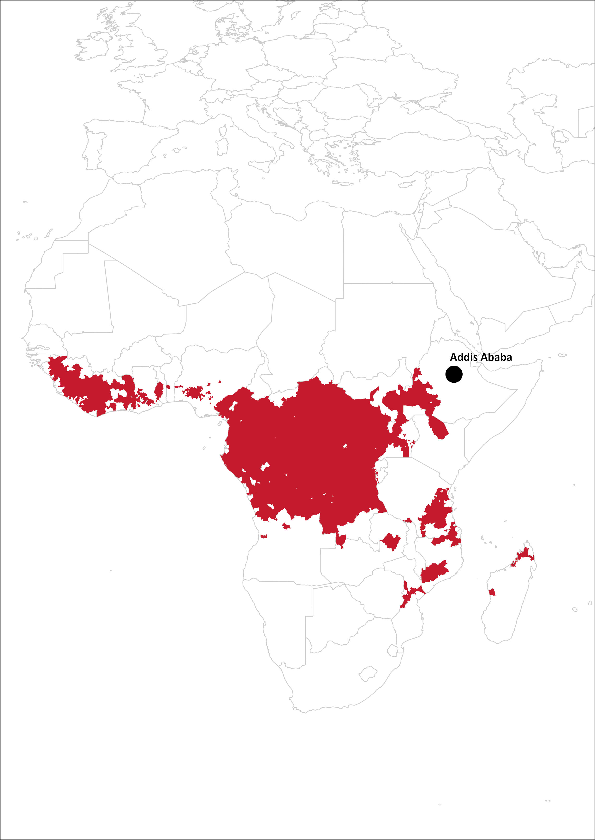
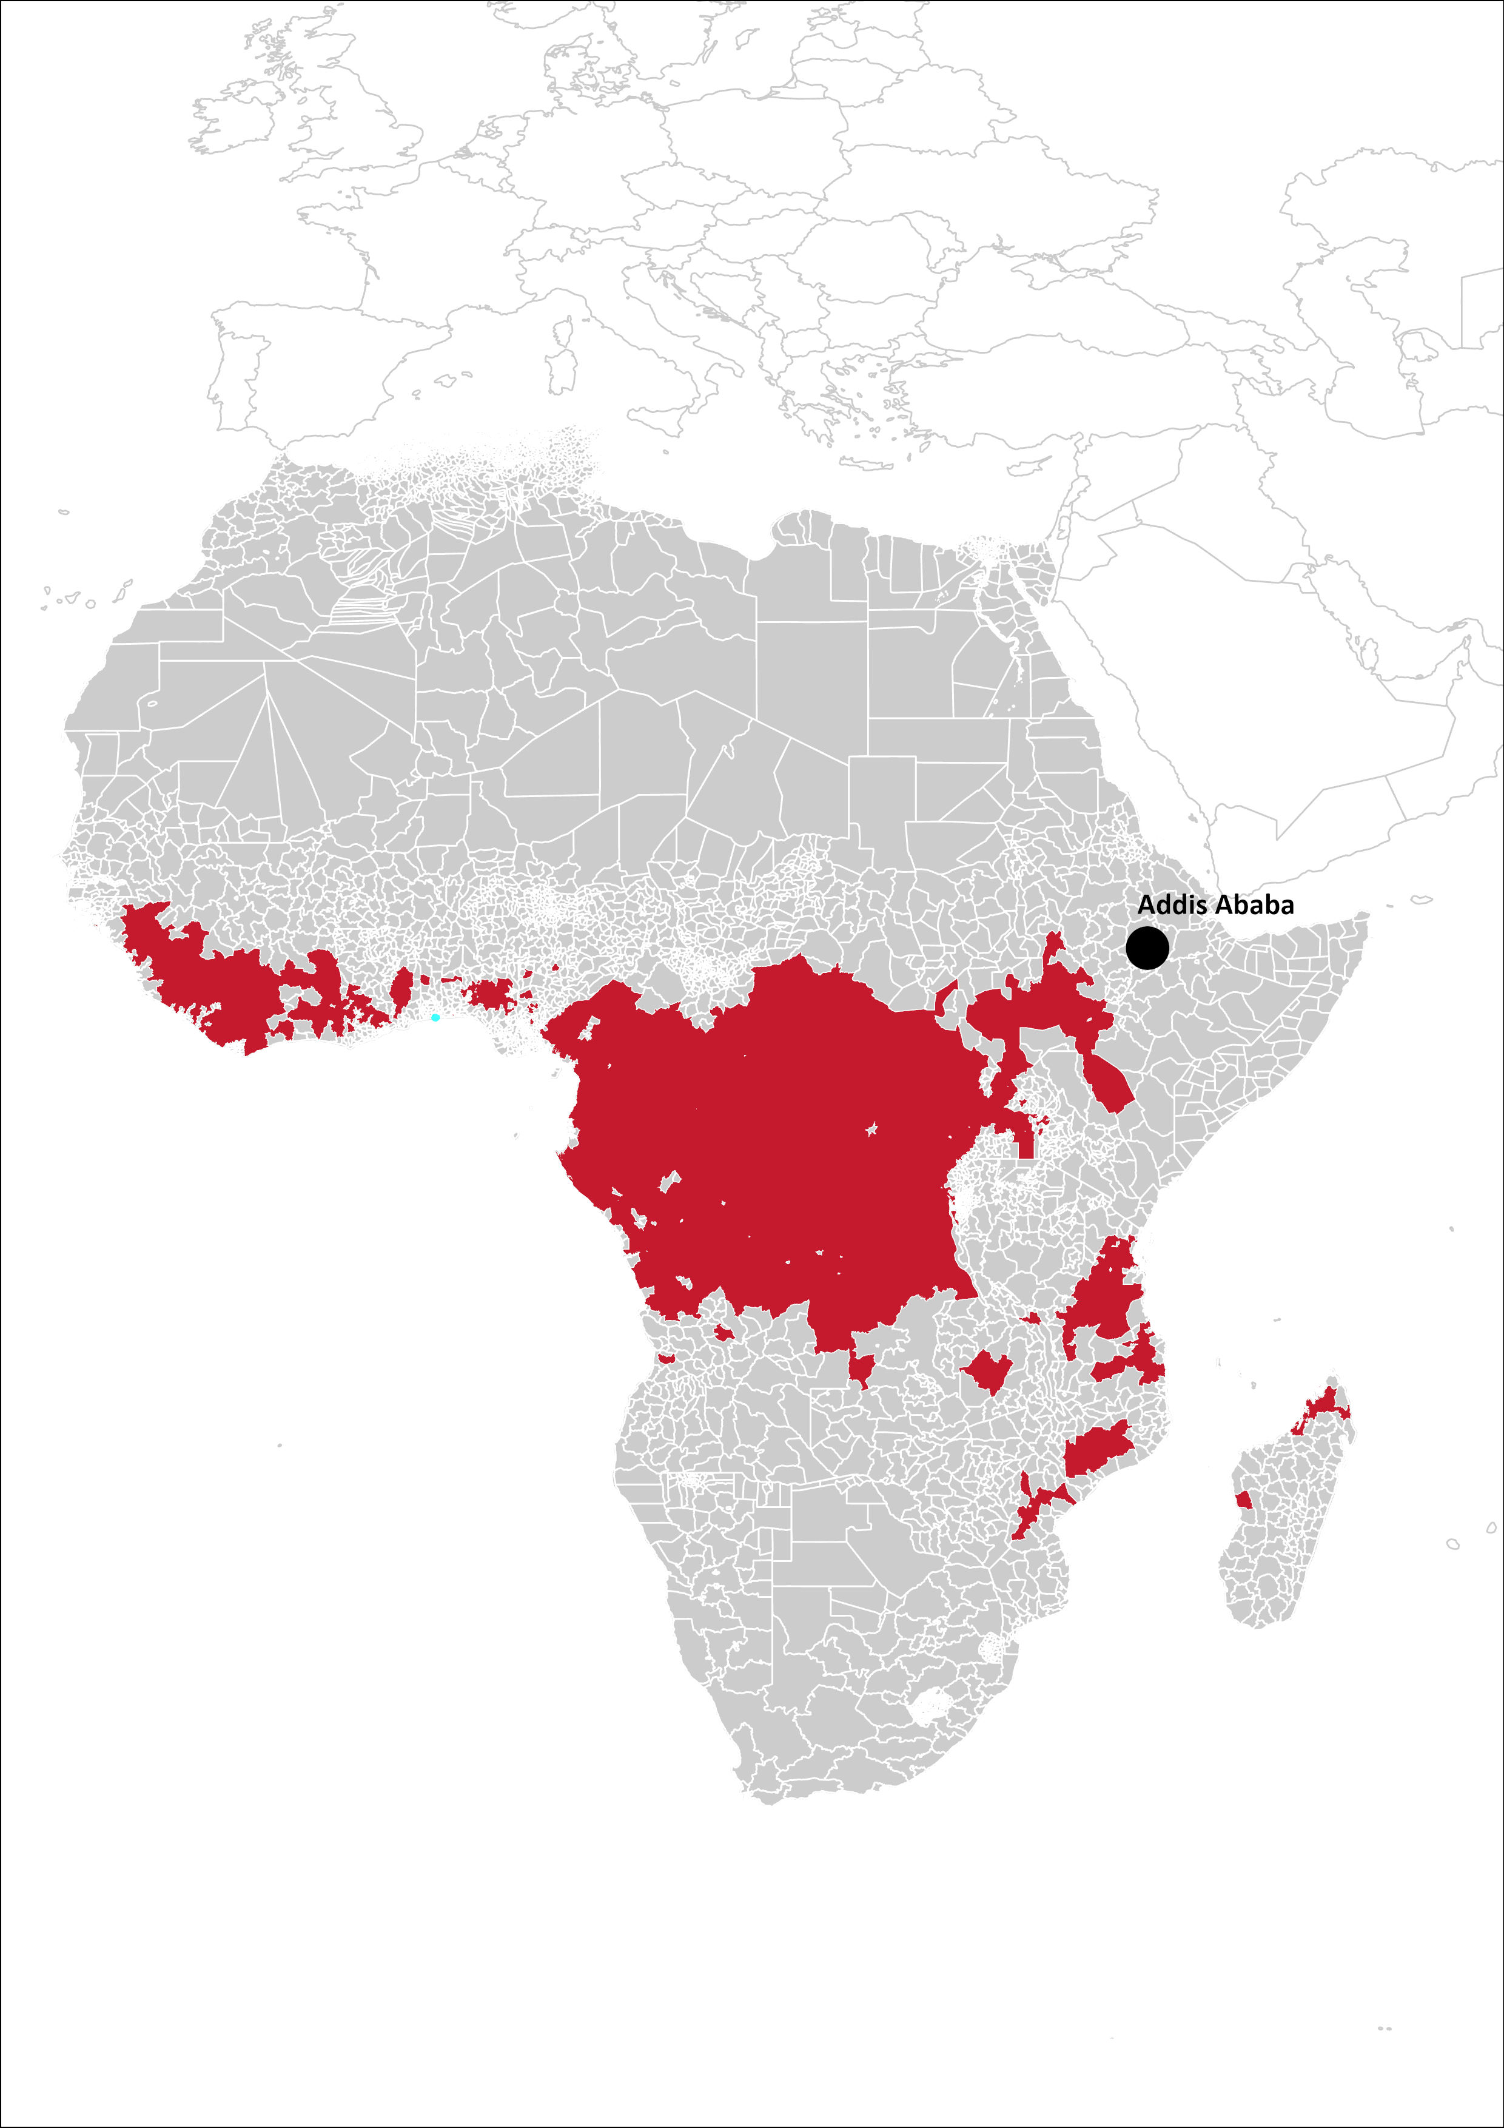
Problem Statement
What we know:
We have a base/warehouse in Addis Ababa.
We know where are the vulnerability area.
What we want to know:
Where to optimally place one new base/warehouse within optimal proximity to high vulnerable areas.

Slide 5
Problem Statement
What we know:
We have a base/warehouse in Addis Ababa.
We know where are the high vulnerability area.
What we want to know:
Where to optimally place one new base/warehouse within proximity to high vulnerable areas.
Notes:
6000+ districts we have

Slide 6



Methods or Tools Used
Methods
Multi-criteria decision making (MCDM) and optimization (Linear Programming).
Tools
Python (pandas, pulp, etc) -> data processing & analysis.
CBC Solver.
ArcGIS -> visualization

Slide 7
Framework
Find most vulnerable, or where highest demand to come from.
Find possible locations for the base/warehouse.
From the possible locations, which one is closest to the highest vulnerability where demand is most likely to come from.

Slide 8
Framework
District with outbreak potential rank of 6 or higher
Find most vulnerable, or where highest demand to come from.
Find possible locations for the base/warehouse.
From the possible locations, which one is closest to the highest vulnerability where demand is most likely to come from.

Slide 9
Framework
District within 10 KM from a large port and 20 km from an international airport with highest LPI
Find most vulnerable, or where highest demand to come from.
Find possible locations for the base/warehouse.
From the possible locations, which one is closest to the highest vulnerability where demand is most likely to come from.

Slide 10
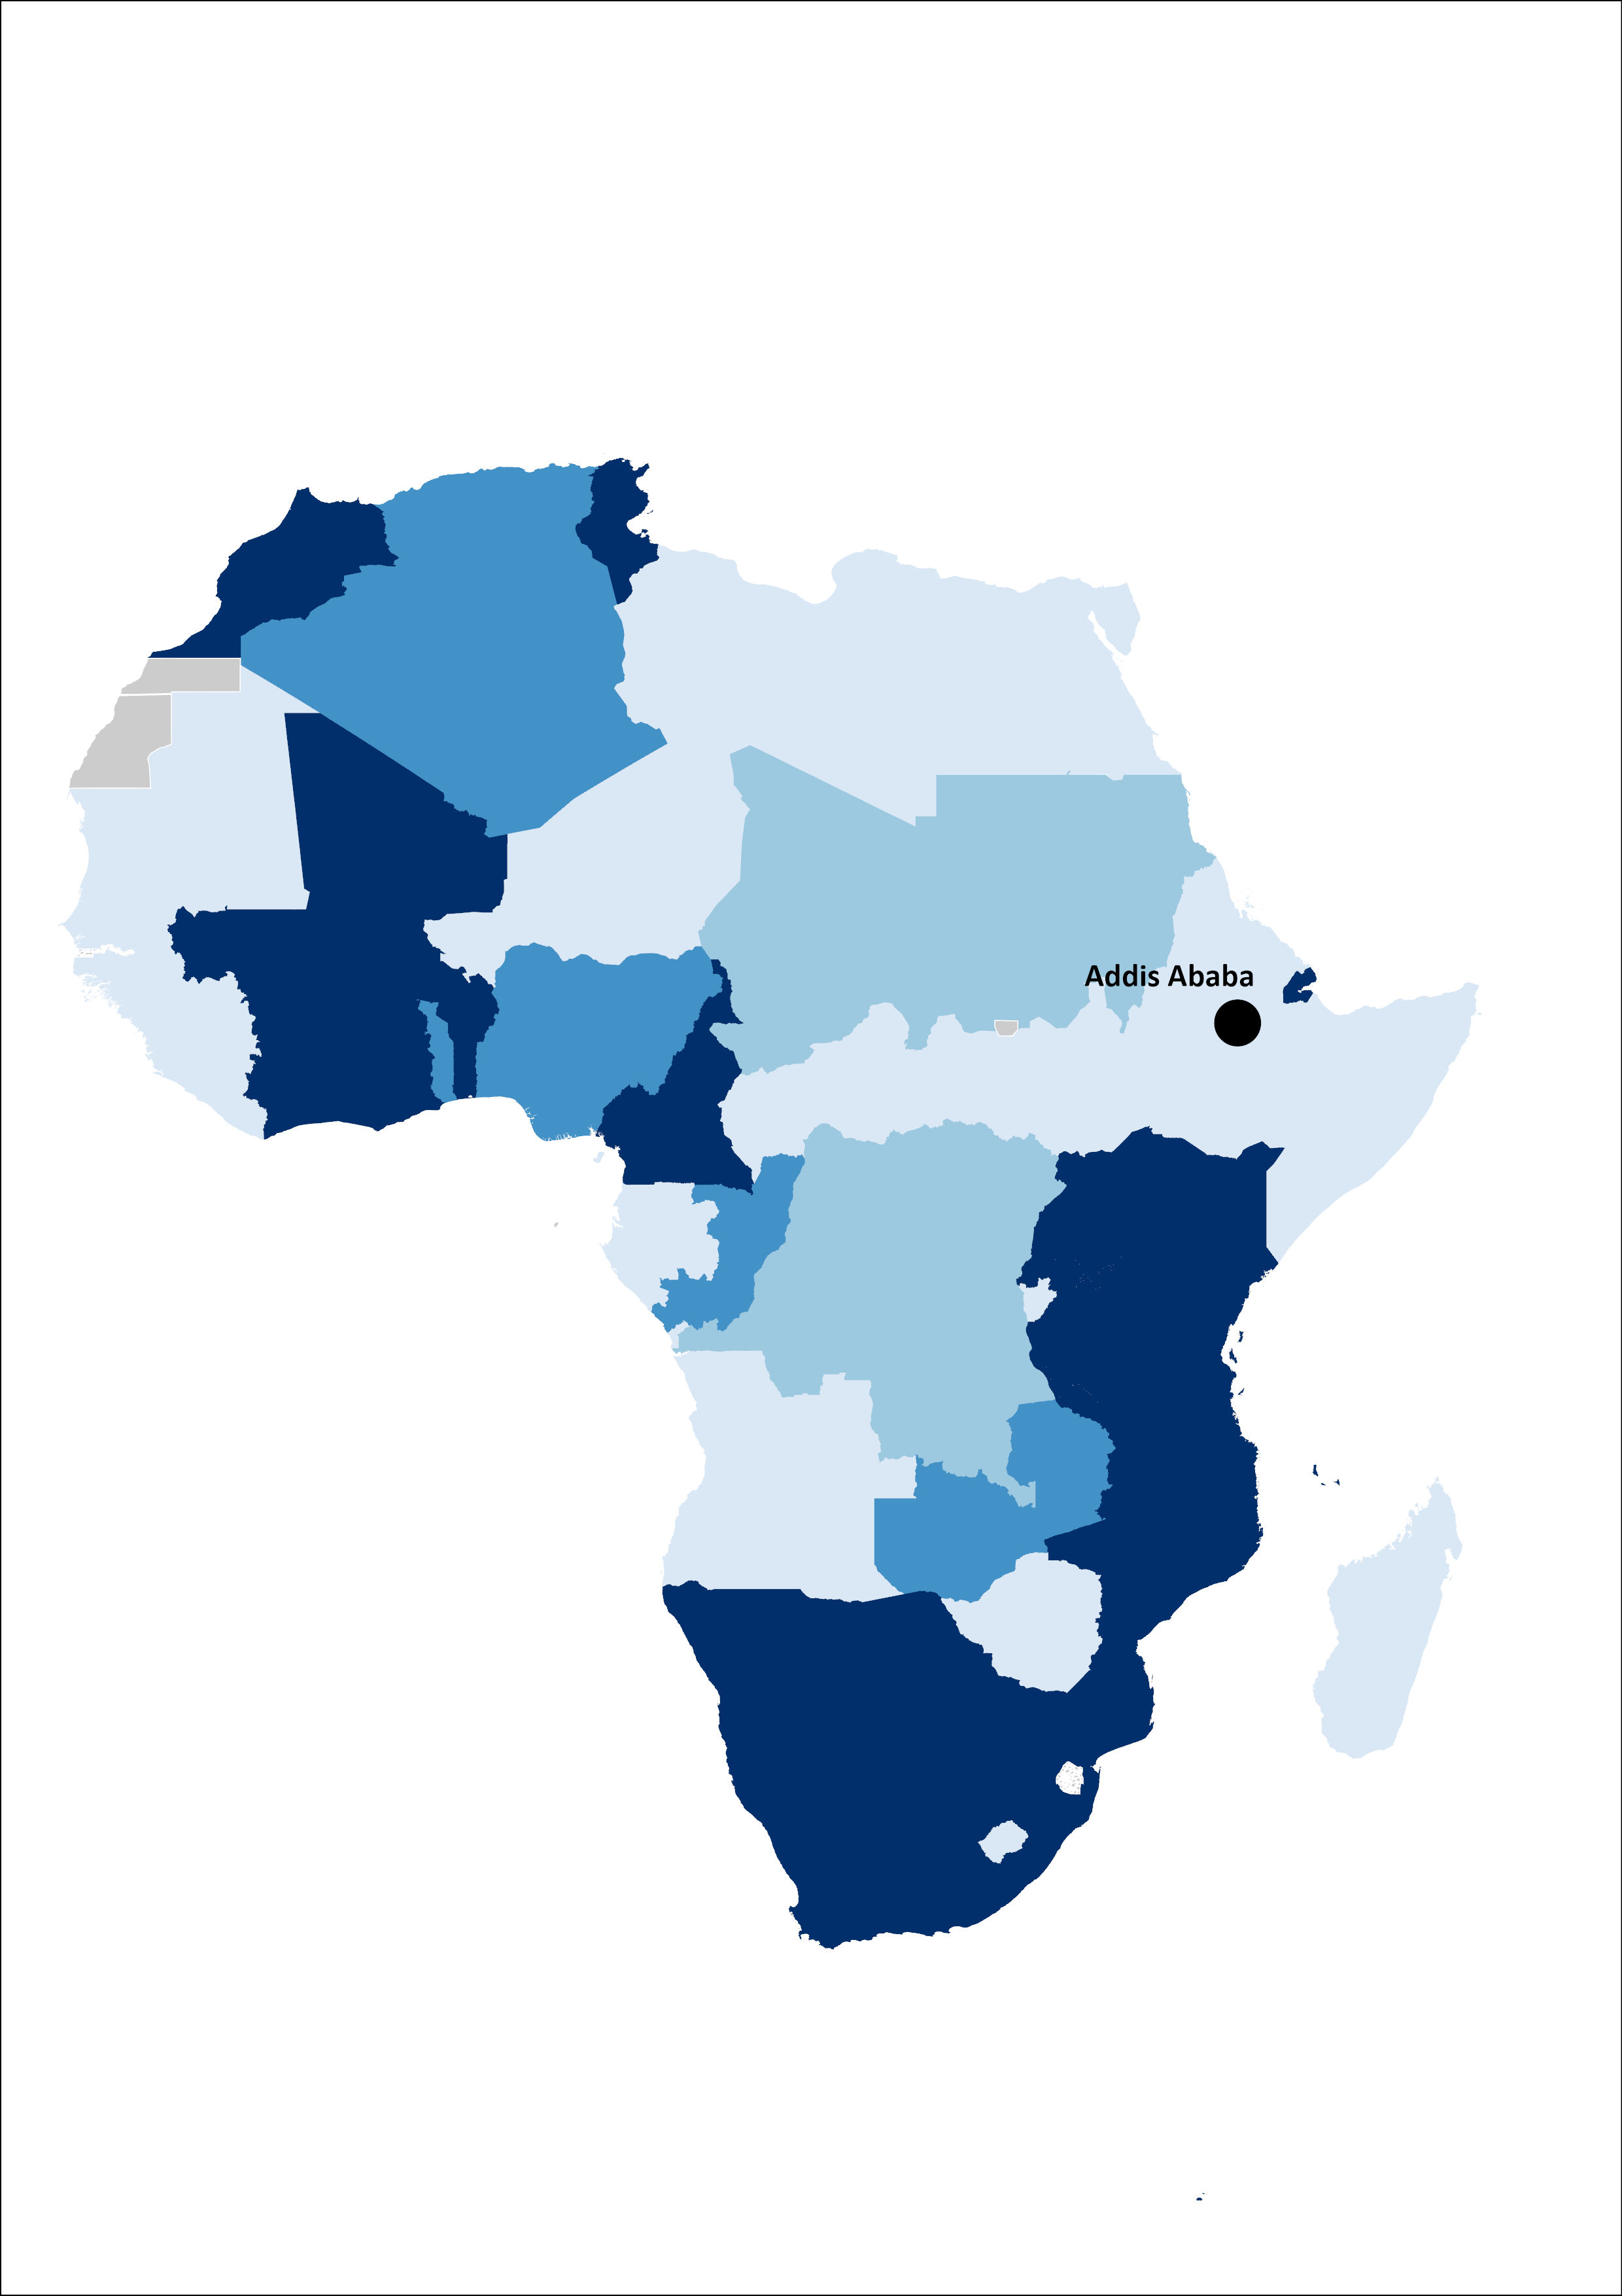
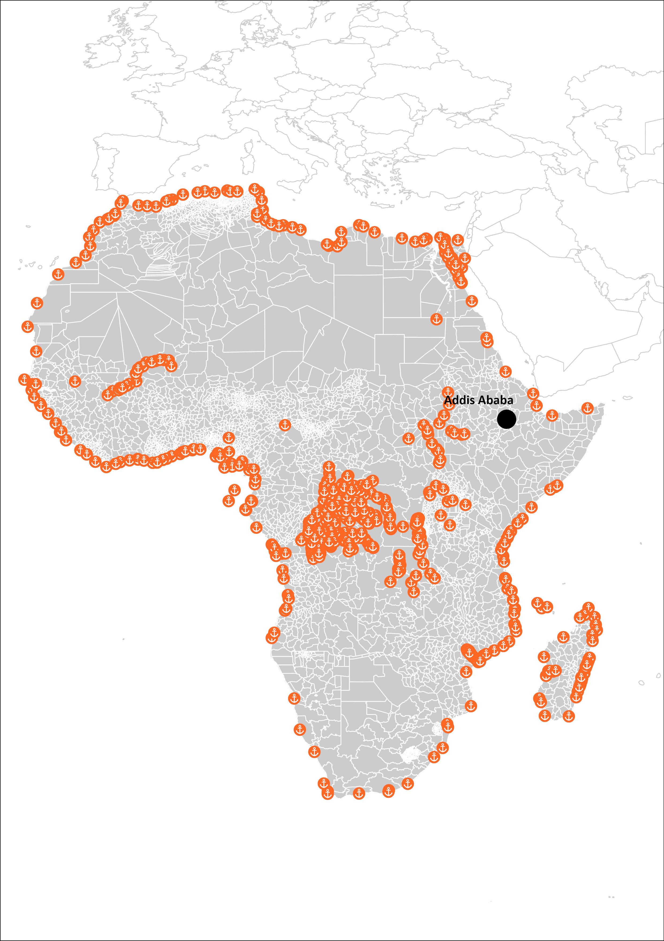
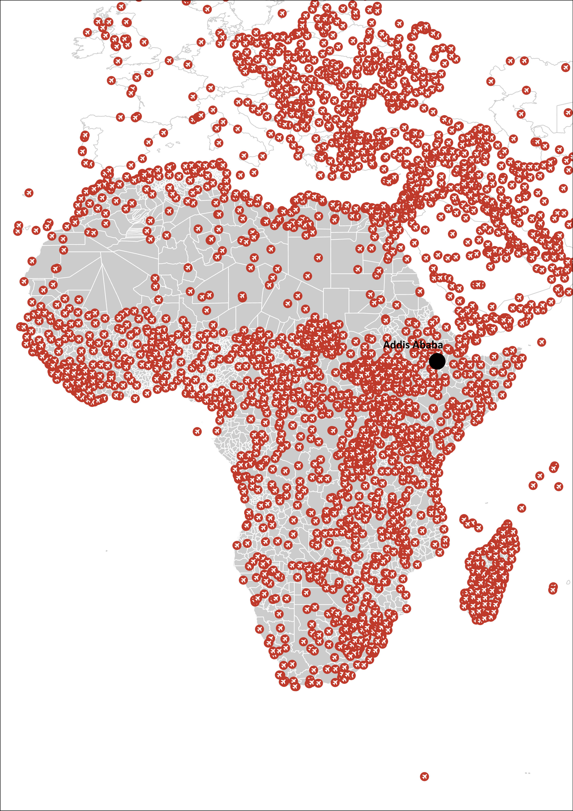
Datasets
Vulnerability / Demand
Other Supporting Criteria
Proximity to Key Facilities
Outbreak Potential.
Location of Port.
Location of Airport.
Country’s Logistics Performance Index.

Slide 11
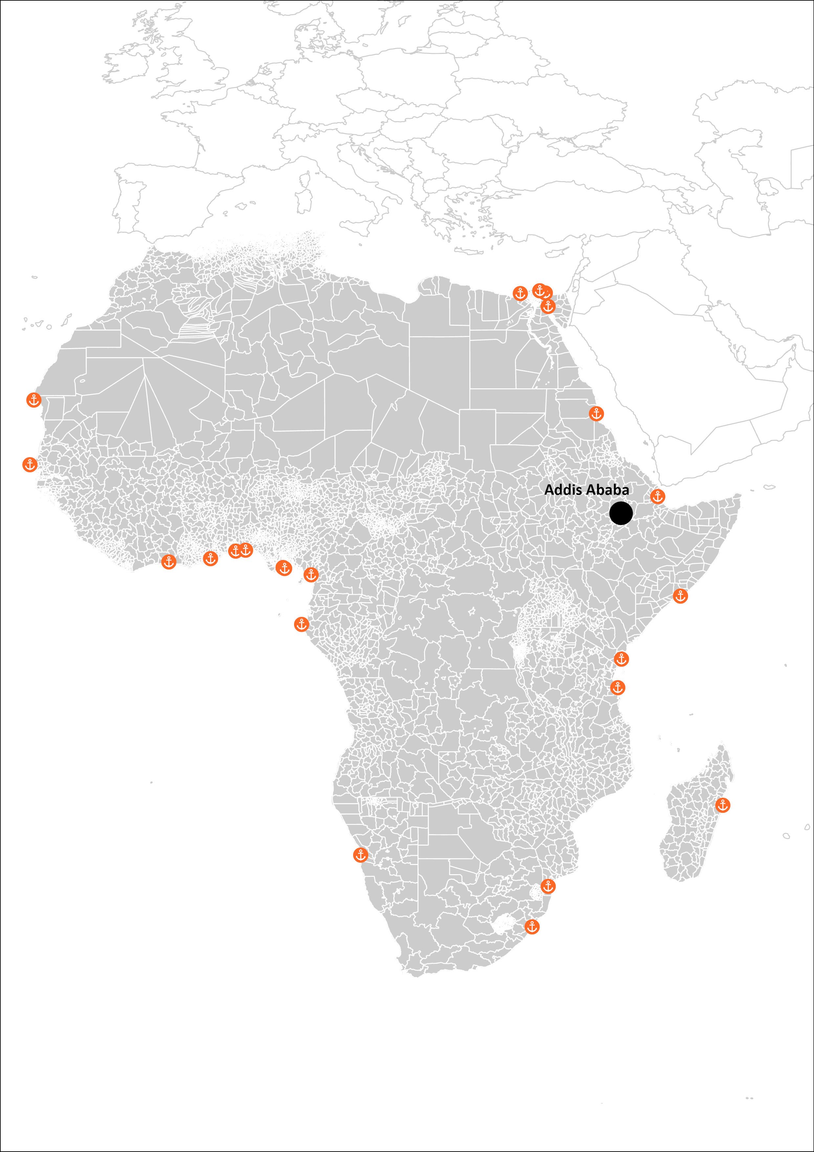
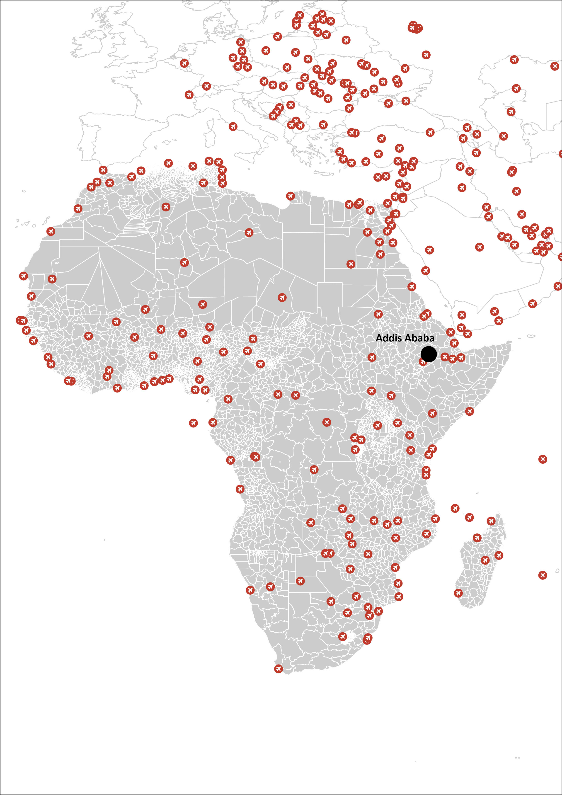
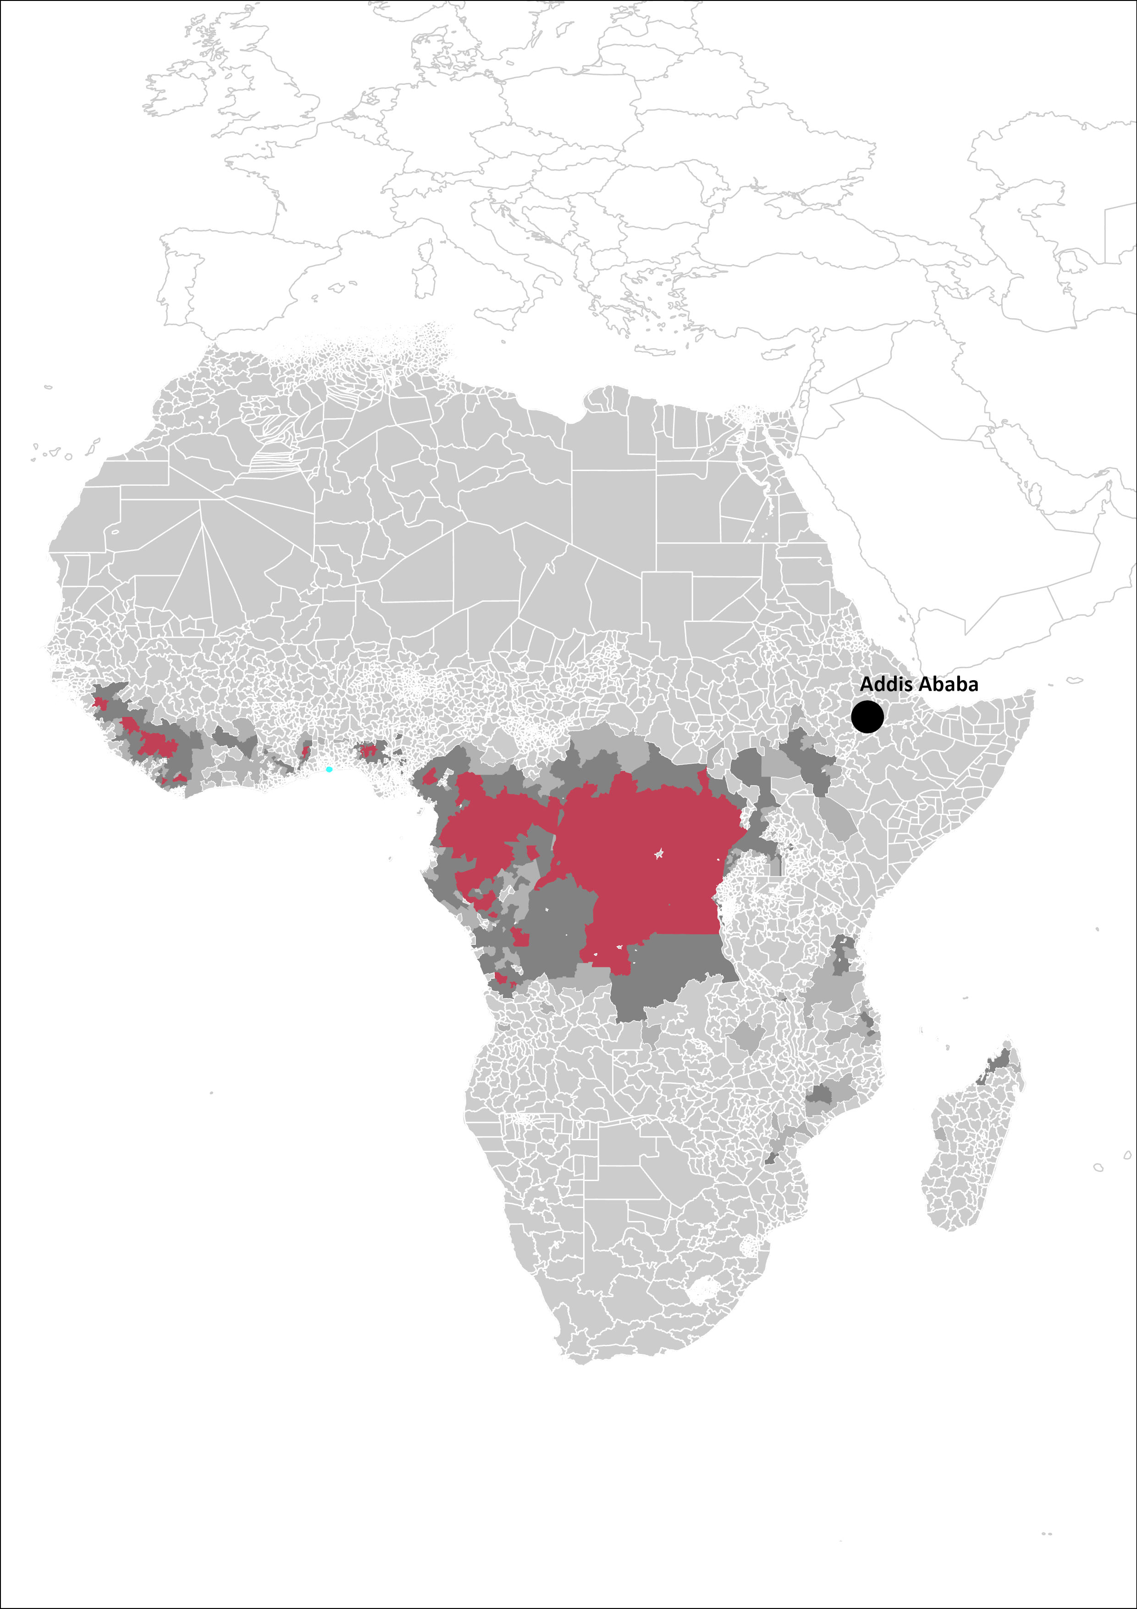
Datasets
Outbreak Potential.
Location of Port.
Location of Airport.
Country’s Logistics Performance Index.

Slide 12
Datasets
Outbreak Potential.
Location of Port.
Location of Airport.
Country’s Logistics Performance Index.
Notes:
Im harshly filtering the data to make it easier for this example

Slide 13
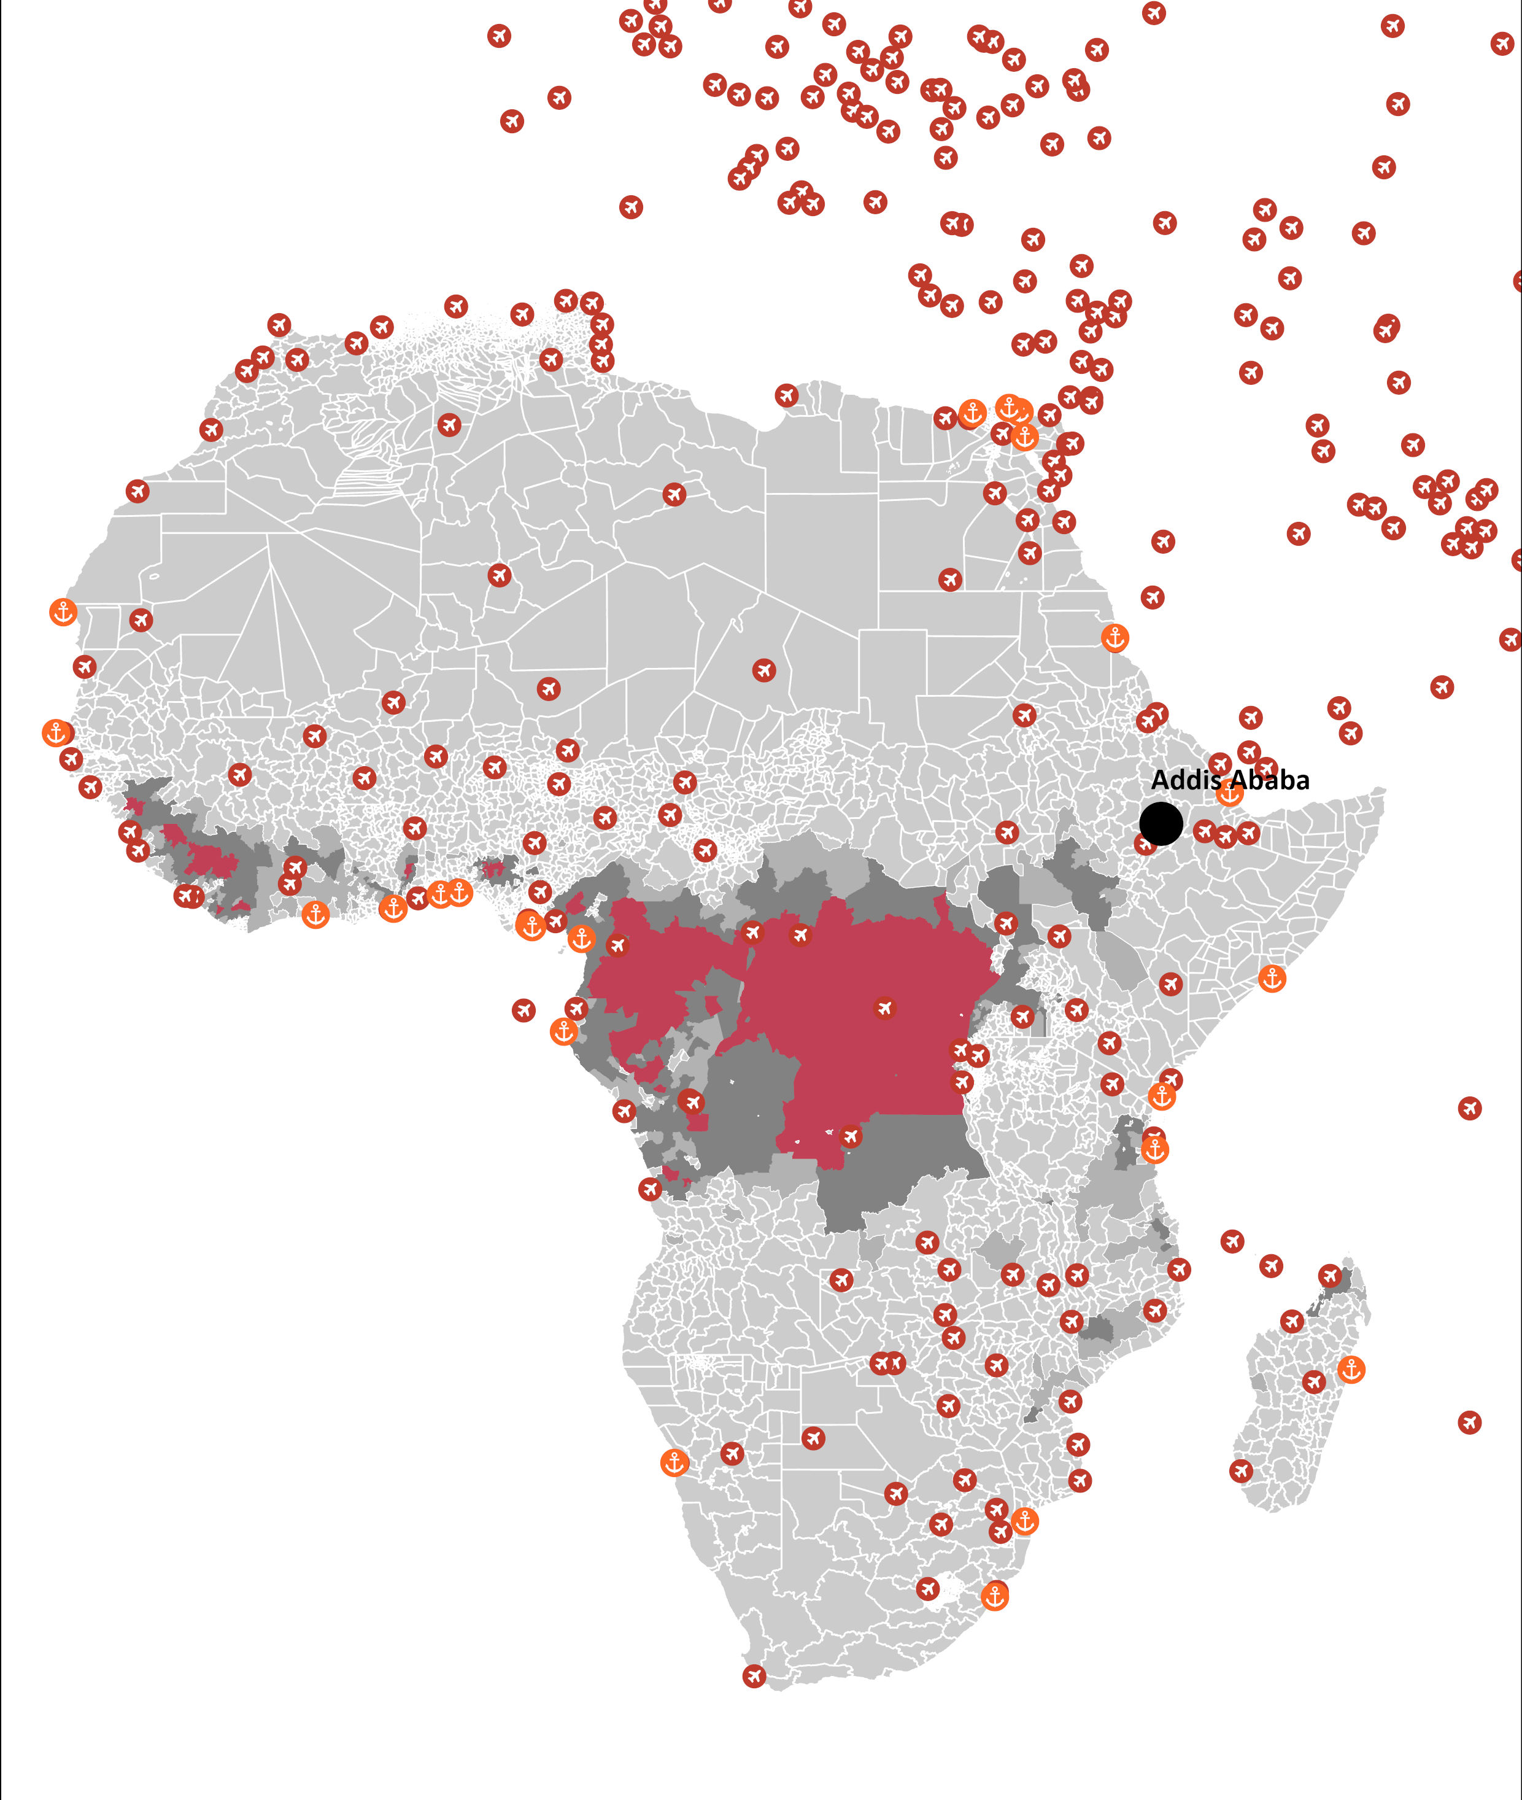
Datasets
Outbreak Potential.
Country’s Logistics Performance Index.
Notes:
The workflow

Slide 14
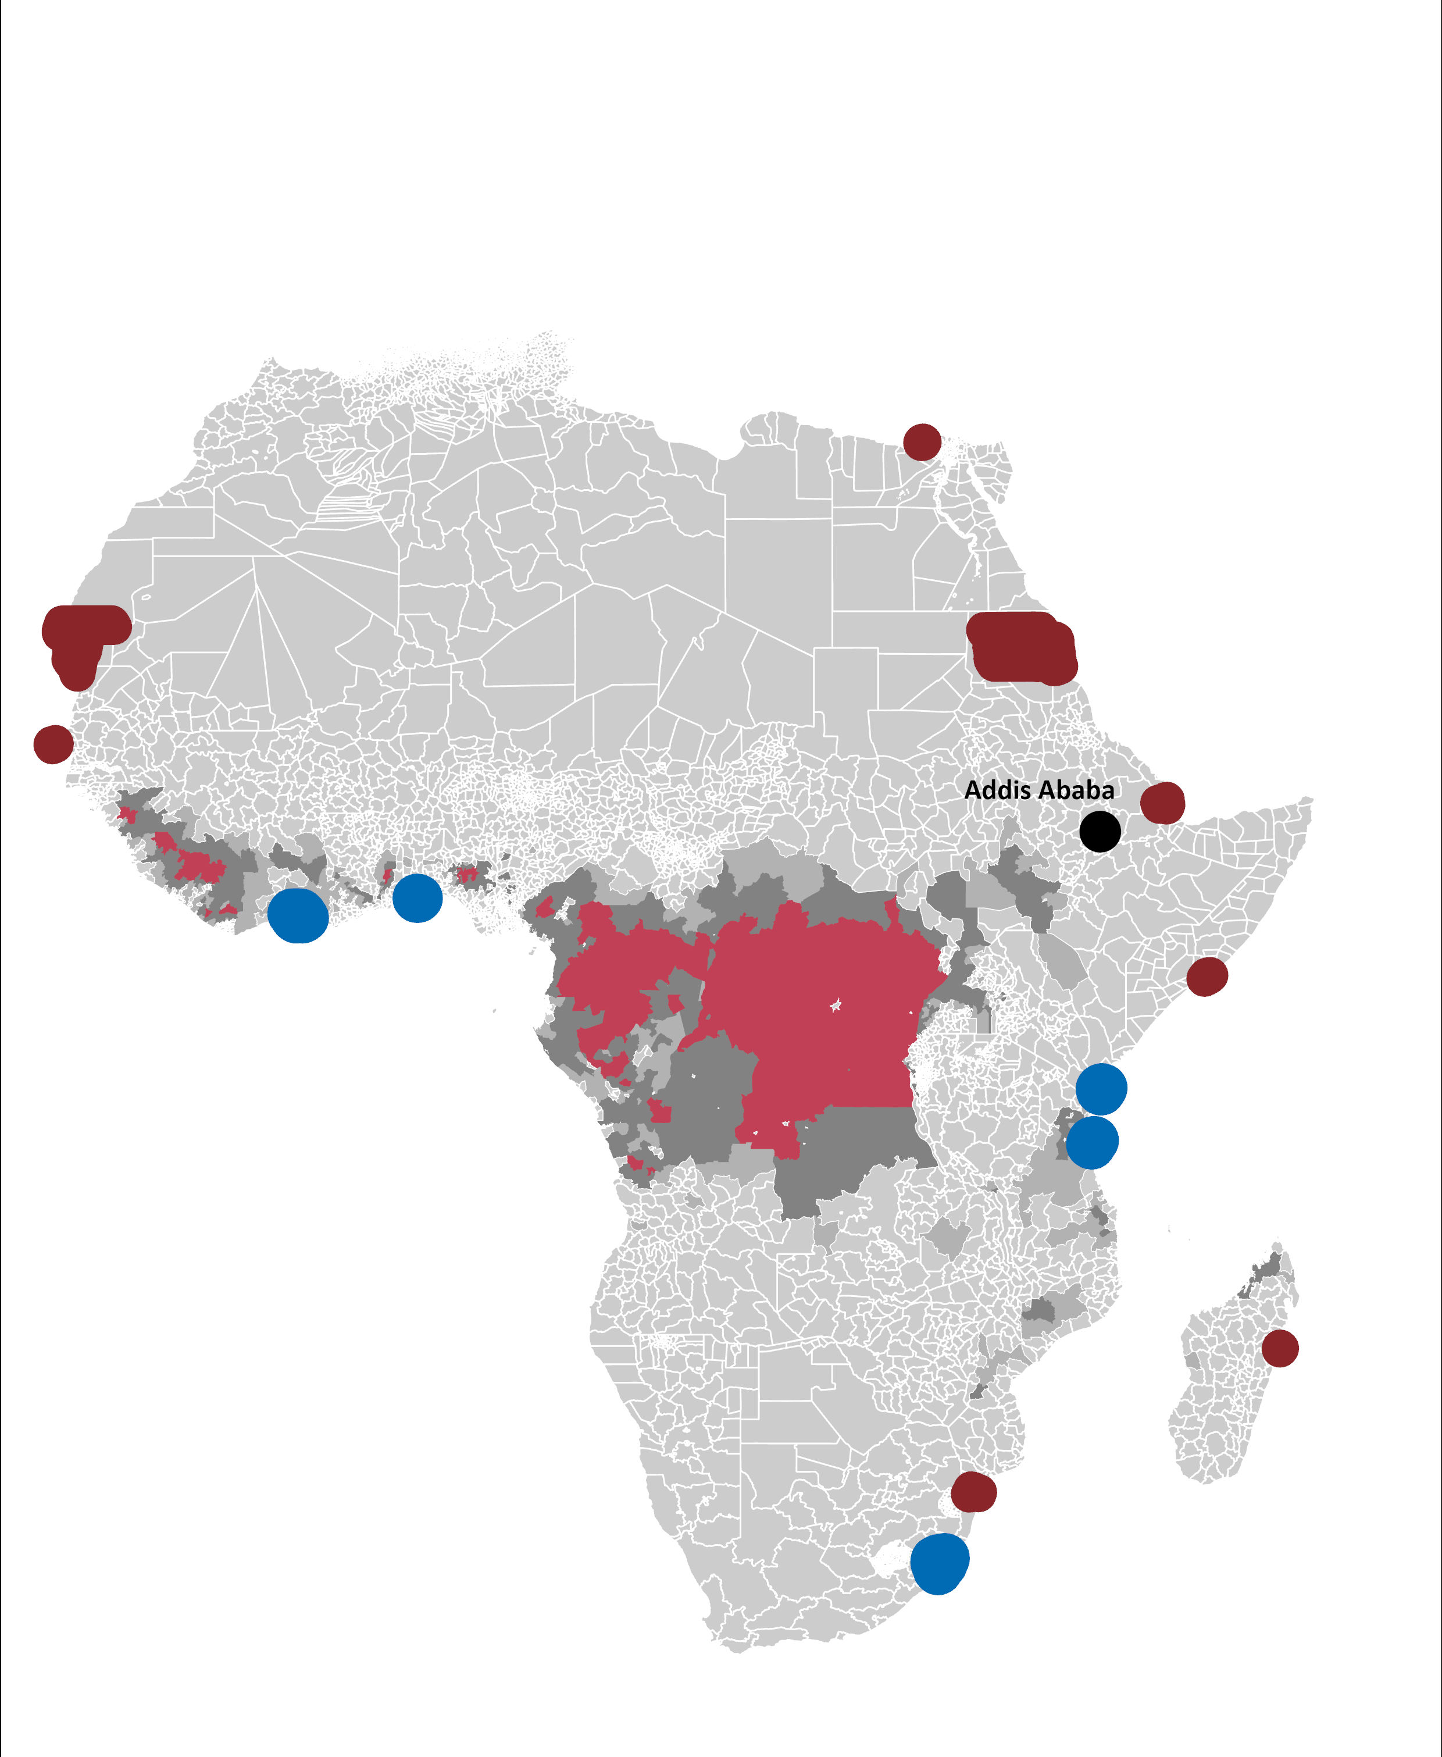
Datasets
Outbreak Potential.
Country’s Logistics Performance Index.
Notes:
We end up with 5 locations in real scenario we may not, you probably also want to compare different scenarios;

Slide 15
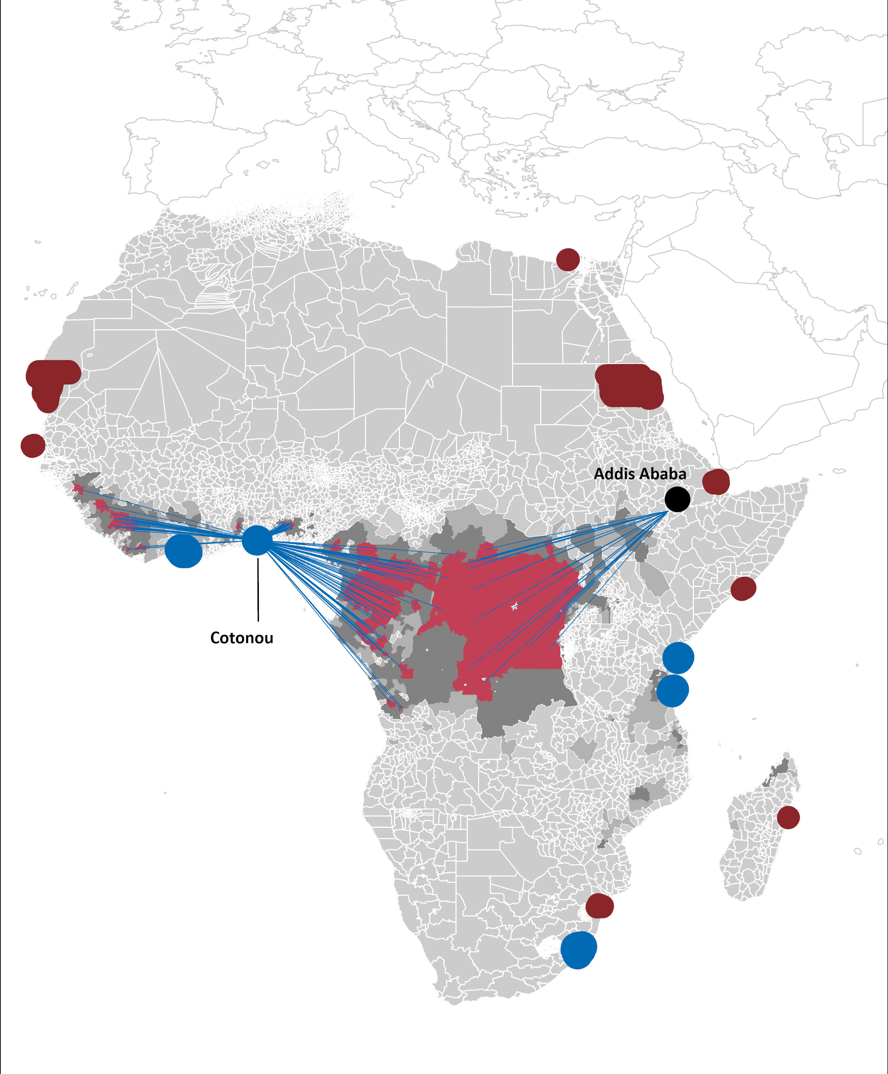
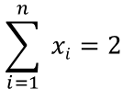
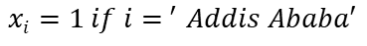
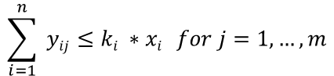
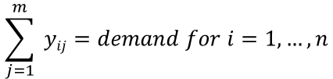
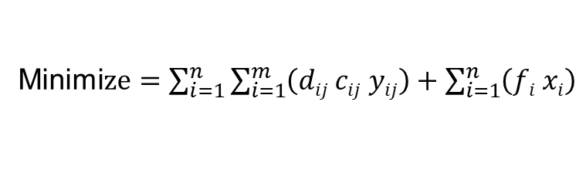
Optimization
Decision Variables
x_{i} = 1 if source location at -i- is selected, 0 if not selected
y_{ij} = amount required to transfer cargo from source location -i- to location -j-
Objective Function
Minimi$ze=\sum_{i=1}^{n}{\sum_{i=1}^{m}{\left(dij cij yij\right)+\sum_{i=1}^{n}{\left(fi xi\right)}}}$
d_{ij} = Distance from location -i- to location -j-
Result
c_{ij} = cost/time from location -i- to location -j-
f_{i} = cost/time associated with operation at location -i-
Constraints
$$\sum_{j=1}^{m}{ yij=demand for i=1,…,n}$$
$$xi=1 if i{= }^{′}Addis Ababa′$$
$$\sum_{i=1}^{n}{ xi=2 }$$
$$\sum_{i=1}^{n}{ yij≤ki ∗xi } for j=1,…, m$$
ki = supply/resource available at location -i-

Slide 16
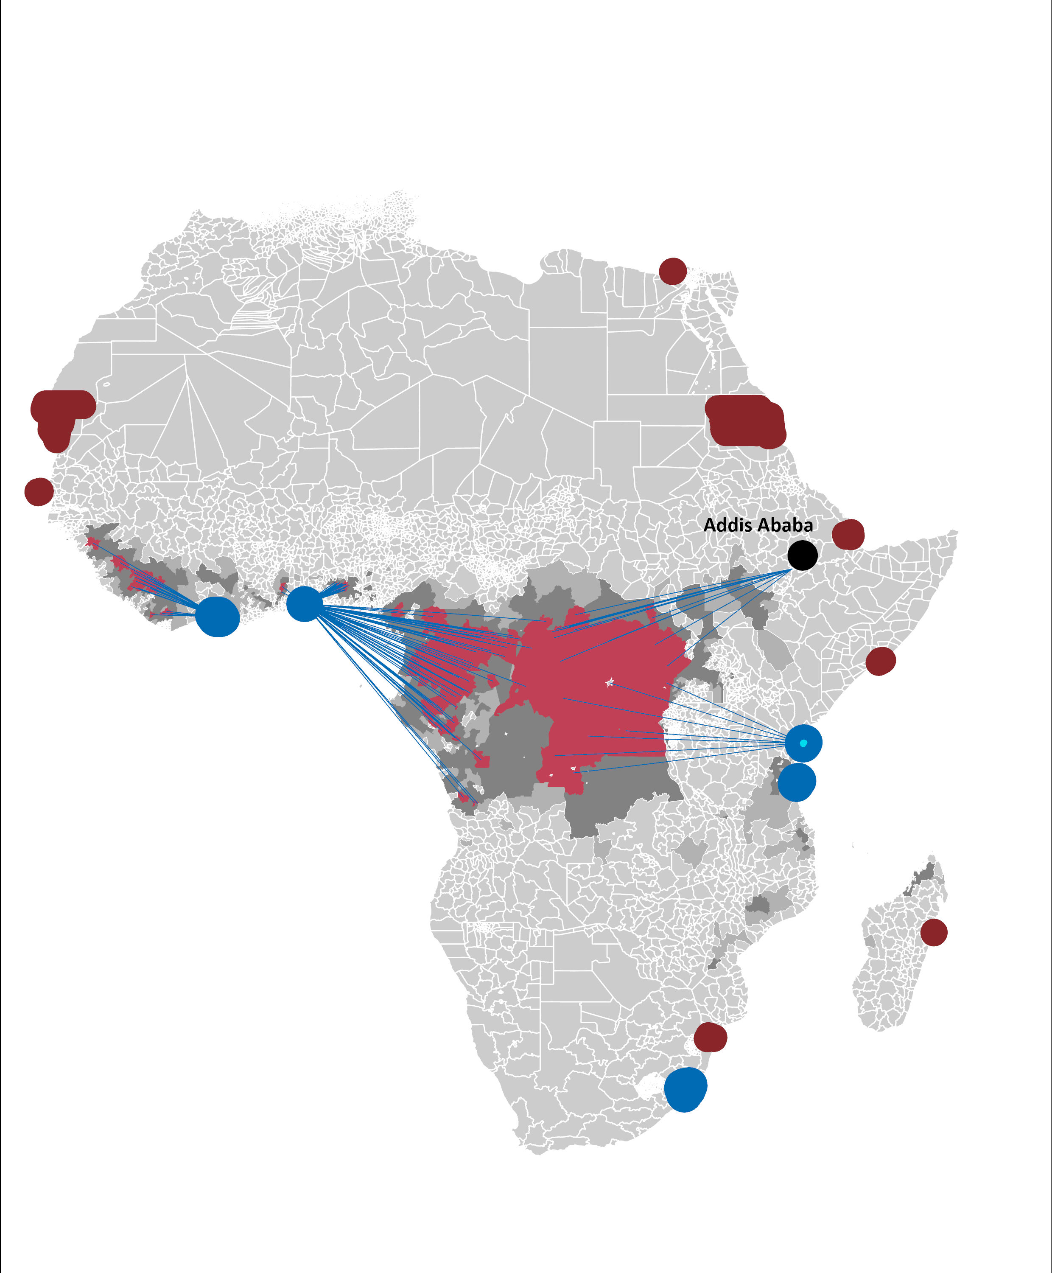
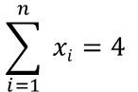
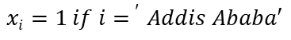
Optimization
Decision Variables
x_{i} = 1 if source location at -i- is selected, 0 if not selected
y_{ij} = amount required to transfer cargo from source location -i- to location -j-
Objective Function
Minimi$ze=\sum_{i=1}^{n}{\sum_{i=1}^{m}{\left(dij cij yij\right)+\sum_{i=1}^{n}{\left(fi xi\right)}}}$
d_{ij} = Distance from location -i- to location -j-
Result – 4 Locations
c_{ij} = cost/time from location -i- to location -j-
f_{i} = cost/time associated with operation at location -i-
Constraints
$$\sum_{j=1}^{m}{ yij=demand for i=1,…,n}$$
$$xi=1 if i{= }^{′}Addis Ababa′$$
$$\sum_{i=1}^{n}{ xi=4 }$$
$$\sum_{i=1}^{n}{ yij≤ki ∗xi } for j=1,…, m$$
ki = supply/recourse available at location -i-

Slide 17
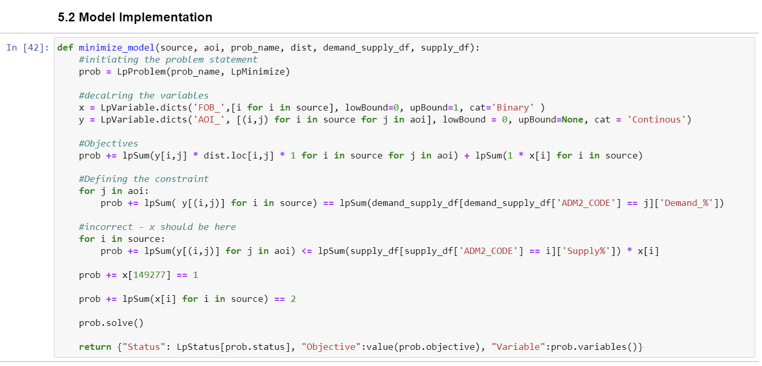
Optimization

Slide 18
Key Learnings
With analytics, it is possible to find the most efficient solution, especially in the case of multivariate decision-making, when human observation are not sufficient to reach an optimal conclusion.
Notes:
There is a lot of things to learn here, however, we could say

Slide 19
Framework
Outbreak Potential.
Location of Port.
Location of Airport.
Country’s Logistics Performance Index.

Slide 20

Thank you for your attention!
https://analyticsbw.org/
https://www.linkedin.com/company/analytics-for-a-better-world/
academy@analyticsbetterworld.org

